Slide 1

https://flic.kr/p/dxGXD
MVC Model Associations
Notes:
Painted Shadows - Not Allowed
Taken from Alexander Calder's mobile room at the National Gallery of Art, Washington DC.

Slide 2
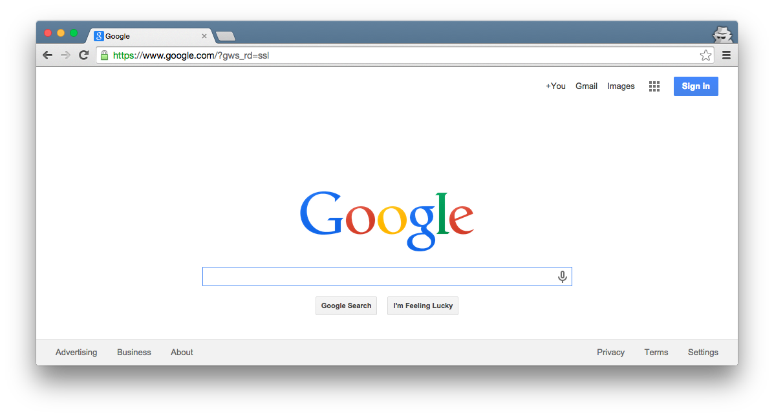

MVC Model Review
Browser
What key capability do Rails model classes provide?
Ye Olde
Internet
DB
Server
View
Router
Controller
Model

Slide 3
MVC Model Review
Browser
What key capability do Rails model classes provide?
Ye Olde
Internet
CRUD persistent data
DB
Server
View
Router
Controller
Model

Slide 4
MVC Model Review
Browser
How do you create Rails model classes?
Ye Olde
Internet
DB
Server
View
Router
Controller
Model

Slide 5
MVC Model Review
Browser
How do you create Rails model classes?
Ye Olde
Internet
Generate DB migrations and model classes with
“rails g model …”
then customize
DB
Server
View
Router
Controller
Model

Slide 6
MVC Model Review
Browser
What purpose do migrations serve?
Ye Olde
Internet
DB
Server
View
Router
Controller
Model

Slide 7
MVC Model Review
Browser
What purpose do migrations serve?
Ye Olde
Internet
Setup tables in DB via, e.g.,
“rake db:migrate:reset” command
DB
Server
View
Router
Controller
Model

Slide 8
MVC Model Review
What DB table would go with this model class?
Model Class:
Database Table:
Author
???
first_name : string
last_name : string
year : integer

Slide 9
MVC Model Review
What DB table would go with this model class?
Model Class:
Database Table:
authors
Author
id | first_name | last_name | year
1 | Ayn | Rand | 1905
2 | Peter | Benchley | 1940
first_name : string
last_name : string
year : integer

Slide 10
MVC Model Review
What DB table would go with this model class?
Model Class:
Database Table:
authors
Author
id | first_name | last_name | year
1 | Ayn | Rand | 1905
2 | Peter | Benchley | 1940
first_name : string
last_name : string
year : integer
Recall Rails ORM
(Object-Relational Mapping)

Slide 11
MVC Model Review
What Author methods does Rails provide “for free”?
Model Class:
Author
first_name : string
last_name : string
year : integer

Slide 12
MVC Model Review
What Author methods does Rails provide “for free”?
Model Class:
Many methods:
Author.create/Author.create!
Author.find
Author.find_by
Author.all
Getters/Setters for attributes
  Author#first_name
  Author#first_name=
Author#save/Author#save!
Author#destroy
Author#valid?
Author
first_name : string
last_name : string
year : integer

Slide 13
MVC Model Review
What customizations might you add to Author?
Model Class:
Author
first_name : string
last_name : string
year : integer

Slide 14

MVC Model Review
What customizations might you add to Author?
Model Class:
Only customization covered so far is data validation
Author
first_name : string
last_name : string
year : integer

Slide 15
Limitation so far:
Insular model classes/tables
Model Class:
Database Table:
authors
Author
id | first_name | last_name | year
1 | Ayn | Rand | 1905
2 | Peter | Benchley | 1940
first_name : string
last_name : string
year : integer

Slide 16
Imagine an author-profile class
Model Class:
Database Table:
authors
Author
id | first_name | last_name | year
1 | Ayn | Rand | 1905
2 | Peter | Benchley | 1940
first_name : string
last_name : string
year : integer
AuthorProfile
author_profiles
birthplace : string
bio : text
awards : text
id | birthplace | bio | awards
23 | Saint Petersburg | Rand was born… | Prometheus Award, …
42 | New York City | He was the son of… | Shark Conservation, …

Slide 17
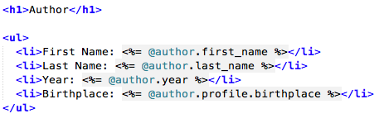
What if you want inter-class relationships?
Author
???
AuthorProfile
first_name : string
last_name : string
year : integer
birthplace : string
bio : text
awards : text
For example, you might want to say:

Slide 18
Requires inter-table references
authors
id | first_name | last_name | year
1 | Ayn | Rand | 1905
2 | Peter | Benchley | 1940
author_profiles
id | birthplace | bio | awards
23 | Saint Petersburg | Rand was born… | Prometheus Award, …
42 | New York City | He was the son of… | Shark Conservation, …

Slide 19
Rails Relationship Support
has one / belongs to one
has many / belongs to one
has and belongs to many
join table
Easiest to learn, but narrow in focus
Most complex, but also most flexible

Slide 20
Rails Relationship Support
has one / belongs to one
has many / belongs to one
has and belongs to many
join table

Slide 21
Has One / Belongs To One Example
Author
AuthorProfile
1
author
has
1
profile
first_name : string
last_name : string
year : integer
birthplace : string
bio : text
awards : text

Slide 22
Has One / Belongs To One Example
Author
AuthorProfile
1
author
has
1
profile
first_name : string
last_name : string
year : integer
birthplace : string
bio : text
awards : text
Class Association

Slide 23
Has One / Belongs To One Example
Author
AuthorProfile
1
author
has
1
profile
first_name : string
last_name : string
year : integer
birthplace : string
bio : text
awards : text
Association Name
Triangle indicates reading direction
(i.e., Author has AuthorProfile)

Slide 24
Has One / Belongs To One Example
Author
AuthorProfile
1
author
has
1
profile
first_name : string
last_name : string
year : integer
birthplace : string
bio : text
awards : text
Role Names
Like attribute/method name
Enables this method call:
@author.profile.birthplace

Slide 25
Has One / Belongs To One Example
Author
AuthorProfile
1
author
has
1
profile
first_name : string
last_name : string
year : integer
birthplace : string
bio : text
awards : text
Multiplicities

Slide 26
Has One / Belongs To One Example
Author
AuthorProfile
1
author
has
1
profile
first_name : string
last_name : string
year : integer
birthplace : string
bio : text
awards : text
Multiplicities
Each Author has 1 AuthorProfile

Slide 27
Has One / Belongs To One Example
Author
AuthorProfile
1
author
has
1
profile
first_name : string
last_name : string
year : integer
birthplace : string
bio : text
awards : text
Multiplicities
Each Author has 1 AuthorProfile
Each AuthorProfile is had by 1 Author

Slide 28
Has One / Belongs To One Example
Author
AuthorProfile
1
author
has
1
profile
first_name : string
last_name : string
year : integer
birthplace : string
bio : text
awards : text
Multiplicities
Each Author has 1 AuthorProfile
Each AuthorProfile is had by 1 Author
More Multiplicities:
A
has
*
B
Each A has 0 or more Bs
A
has
0..*
B
Each A has 0 or more Bs
A
has
1..*
B
Each A has 1 or more Bs

Slide 29
Has One / Belongs To One Example
Author
AuthorProfile
1
author
has
1
profile
first_name : string
last_name : string
year : integer
birthplace : string
bio : text
awards : text
Associated DB Tables
authors
id | first_name | last_name | year
1 | Ayn | Rand | 1905
2 | Peter | Benchley | 1940
author_profiles
id | author _id | birthplace | bio | awards
23 | 1 | Saint Petersburg | Rand was born… | Prometheus Award, …
42 | 2 | New York City | He was the son of… | Shark Conservation, …

Slide 30
Has One / Belongs To One Example
Author
AuthorProfile
1
author
has
1
profile
first_name : string
last_name : string
year : integer
birthplace : string
bio : text
awards : text
Associated DB Tables
authors
id | first_name | last_name | year
1 | Ayn | Rand | 1905
2 | Peter | Benchley | 1940
references
author_profiles
id | author _id | birthplace | bio | awards
23 | 1 | Saint Petersburg | Rand was born… | Prometheus Award, …
42 | 2 | New York City | He was the son of… | Shark Conservation, …

Slide 31
Primary versus Foreign Keys
Primary Key: Uniquely identifies each record in table
authors
id | first_name | last_name | year
1 | Ayn | Rand | 1905
2 | Peter | Benchley | 1940
author_profiles
id | author _id | birthplace | bio | awards
23 | 1 | Saint Petersburg | Rand was born… | Prometheus Award, …
42 | 2 | New York City | He was the son of… | Shark Conservation, …

Slide 32
Primary versus Foreign Keys
Primary Key: Uniquely identifies each record in table
Foreign Key: Field in table A such that the field is a primary key in one other table B
authors
id | first_name | last_name | year
1 | Ayn | Rand | 1905
2 | Peter | Benchley | 1940
author_profiles
id | author _id | birthplace | bio | awards
23 | 1 | Saint Petersburg | Rand was born… | Prometheus Award, …
42 | 2 | New York City | He was the son of… | Shark Conservation, …

Slide 33
Primary versus Foreign Keys
Primary Key: Uniquely identifies each record in table
Foreign Key: Field in table A such that the field is a primary key in one other table B
authors
id | first_name | last_name | year
1 | Ayn | Rand | 1905
2 | Peter | Benchley | 1940
author_profiles
id | author _id | birthplace | bio | awards
23 | 1 | Saint Petersburg | Rand was born… | Prometheus Award, …
42 | 2 | New York City | He was the son of… | Shark Conservation, …

Slide 34
Goal: Associate Each Author with an AuthorProfile
Generate AuthorProfile class (no references)
Generate migration to add references
Customize model class by adding association
Add seed data for AuthorProfile
In “show” view, show profile data

Slide 35
Rails Relationship Support
has one / belongs to one
has many / belongs to one
has and belongs to many
join table

Slide 36
Has Many / Belongs to One Example
Author
AuthorProfile
1
author
has
1
profile
first_name : string
last_name : string
year : integer
birthplace : string
bio : text
awards : text
Book
How to model authorship?
(assume 1 author per book)
title : string
year : integer
summary : text

Slide 37
Has Many / Belongs to One Example
Author
AuthorProfile
1
author
has
1
profile
first_name : string
last_name : string
year : integer
birthplace : string
bio : text
awards : text
1 author
has
* book
Book
How to model authorship?
(assume 1 author per book)
title : string
year : integer
summary : text

Slide 38
Has Many / Belongs to One Example
What should the ORM be?
(hint: authors table unchanged)
Author
first_name : string
last_name : string
year : integer
authors
1 author
id | first_name | last_name | year
1 | Ayn | Rand | 1905
2 | Peter | Benchley | 1940
has
* book
Book
title : string
year : integer
summary : text

Slide 39
Has Many / Belongs to One Example
What should the ORM be?
(hint: authors table unchanged)
Author
first_name : string
last_name : string
year : integer
authors
1 author
id | first_name | last_name | year
1 | Ayn | Rand | 1905
2 | Peter | Benchley | 1940
has
* book
Book
title : string
year : integer
summary : text
books
id | title | year | summary | author_id
72 | The Fountainhead | 1943 | Individualistic architect… | 1
98 | Atlas Shrugged | 1957 | Dystopian USA… | 1
99 | Jaws | 1974 | Shark!... | 2

Slide 40
Has Many / Belongs to One Example
What should the ORM be?
(hint: authors table unchanged)
Author
first_name : string
last_name : string
year : integer
authors
1 author
id | first_name | last_name | year
1 | Ayn | Rand | 1905
2 | Peter | Benchley | 1940
has
* book
Book
title : string
year : integer
summary : text
books
id | title | year | summary | author_id
72 | The Fountainhead | 1943 | Individualistic architect… | 1
98 | Atlas Shrugged | 1957 | Dystopian USA… | 1
99 | Jaws | 1974 | Shark!... | 2

Slide 41
Has Many / Belongs to One Example
Rails generates “books” method that returns list of books
Author
first_name : string
last_name : string
year : integer
authors
1 author
id | first_name | last_name | year
1 | Ayn | Rand | 1905
2 | Peter | Benchley | 1940
has
* book
Book
title : string
year : integer
summary : text
books
id | title | year | summary | author_id
72 | The Fountainhead | 1943 | Individualistic architect… | 1
98 | Atlas Shrugged | 1957 | Dystopian USA… | 1
99 | Jaws | 1974 | Shark!... | 2

Slide 42
Goal: Associate Each Author with Books Authored
Generate Books class (no references)
Generate migration to add references
Customize model classes by adding association
Add seed data for Books
In “show” view, show books data

Slide 43
Rails Relationship Support
has one / belongs to one
has many / belongs to one
has and belongs to many
join table

Slide 44
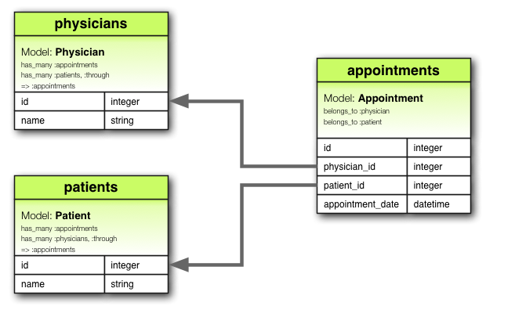
Join Table Example
From http://guides.rubyonrails.org/v4.2.0/association_basics.html

Slide 45
Join Table Example
Join table
From http://guides.rubyonrails.org/v4.2.0/association_basics.html

Slide 46
Join Table Example
References
(aka foreign keys)
From http://guides.rubyonrails.org/v4.2.0/association_basics.html

Slide 47
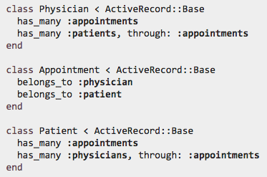
Join Table Example: Model Class
“through” enables this sort of thing:
From http://guides.rubyonrails.org/v4.2.0/association_basics.html

Slide 48
Rails Relationship Support
has one / belongs to one
has many / belongs to one
has and belongs to many
join table
For more info, see…
Rails Guide Chapter:
http://guides.rubyonrails.org/v4.2.4/association_basics.html
API Documentation:
http://api.rubyonrails.org/v4.2.4/classes/ActiveRecord/Associations/ClassMethods.html

Slide 49
Appendix

Slide 50
Has One / Belongs To One Example
Author
AuthorProfile
1
author
has
1
profile
first_name : string
last_name : string
year : integer
birthplace : string
bio : text
awards : text
Associated DB Tables
authors
id | first_name | last_name | year
1 | Ayn | Rand | 1905
2 | Peter | Benchley | 1940
references
author_profiles
id | author _id | birthplace | bio | awards
23 | 1 | Saint Petersburg | Rand was born… | Prometheus Award, …
42 | 2 | New York City | He was the son of… | Shark Conservation, …

Slide 51
Has Many / Belongs to One Example
Author
first_name : string
last_name : string
year : integer
authors
1 author
id | first_name | last_name | year
1 | Ayn | Rand | 1905
2 | Peter | Benchley | 1940
has
* book
references
Book
title : string
year : integer
summary : text
books
id | title | year | summary | author_id
72 | The Fountainhead | 1943 | Individualistic architect… | 1
98 | Atlas Shrugged | 1957 | Dystopian USA… | 1
99 | Jaws | 1974 | Shark!... | 2

